Slide 1
Welcome back to HOG Tech University
I’m Andrew Beirnes
Welding Engineer & Certified Welding Inspector

Slide 2
Cutting Processes
WELDER TRAINING UNIT 8 & 9

Slide 3
Plasma Cutting
WELDER TRAINING UNIT 8

Slide 4
OBJECTIVES
PROCESS BASICS
COMPONENTS
EQUIPMENT SETTINGS
TECHNIQUES

Slide 5
PROCESS BASICS (pLASMA cUTTING)
Plasma Cutting Uses an arc similar to GTAW blown into a plasma jet using compressed gas.
The Plasma melts the material while the compressed gas removes the material.
There are two modes/styles of plasma cutting.
Indirect (Self Arcing)- The plasma is not transferred to the base material the torch arcs back on itself and uses the compressed gas to push the heat from the arc to the base material.
Direct - The arc is established between the workpiece and the torch and the gas removes the molten material.

Slide 6
equipment setup
Setup Shots.
-Plug in Cutter
- Power Switch
- Shop Air
- Ground
Plug in the Welder
Power Switch Location
Connect to Gas (Shop Air)
Ground Placement

Slide 7
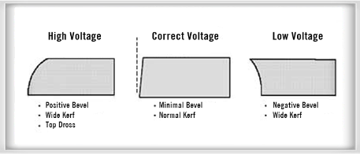
equipment settings
Setup Shots.
Amperage
Main setting on a Plasma Cutting machine.
Amperage
Too High of amperage and the cut will taper/round off.
Too Low of amperage and the cut will be wider at the bottom than the top.
Correct amperage will still have a taper but a consistent angle and minimal kerf.
http://www.promotioncontrols.com/cutting-tips-and-tricks-char2.php

Slide 8
Arc Initiation
Starting a Plasma cutter.
HOG uses pilot arc plasma cutters meaning they self arc to start then the arc moves to the work piece.
When plunging a cut start the arc and move higher to avoid molten material getting into the drag shield or tip.
There should be a standoff of about ¼” between the drag shield and the workpiece.

Slide 9
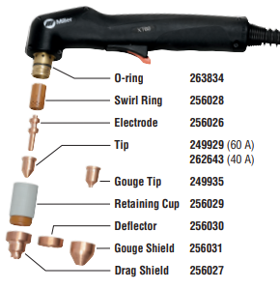
Replacing consumables
Show Worn out components
Replacement of parts are required as the gun wears, parts should be on hand in the parts room.
When plunging a cut start the arc and move higher to avoid molten material getting into the drag shield or tip.
https://www.millerwelds.com/-/media/miller-electric/imported-mam-assets/spec-sheets/5/c/8/pc9-8.pdf

Slide 10
dross removal
Removing Dross from a plasma cutter.
Always remove dross from the back edge of the cut and the face of the cut prior to subsequent processing.
This can be achieved with a grinder, rotary file, or other mechanical means.

Slide 11
oxy-fuel Cutting
WELDER TRAINING UNIT 9

Slide 12
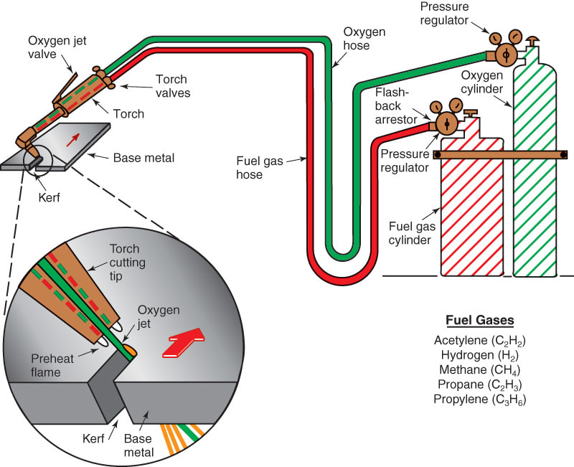
PROCESS BASICS (oxy-fuel cUTTING)
Oxy-Fuel Gas uses the exothermic reaction between iron and oxygen to cut material.
In essence the process is “burning” the steel by rapidly oxidizing the iron in the steel (rusing).
For this reason Oxy-Fuel cutting is limited to carbon steels. Stainless steels are rust-resistant making them resistant to the cutting action.
Due to the exothermic nature of the process there is no theoretical limit to cutting thickness so long as enough oxygen is applied.
http://www.halversoncts.com/43-oxygen-cutting-process.html

Slide 13
PROCESS BASICS (oxy-fuel cUTTING)
Show Gas Cylinders.
Setting the pressure.
Typical gas used is Acetylene.
Acetylene setting is around 5-10psi
Acetylene becomes unstable above 15psi
Oxygen must be pure 99.8%
Oxygen is typically set around 60 psi however can be increased based on thickness of material.
http://www.halversoncts.com/43-oxygen-cutting-process.html

Slide 14
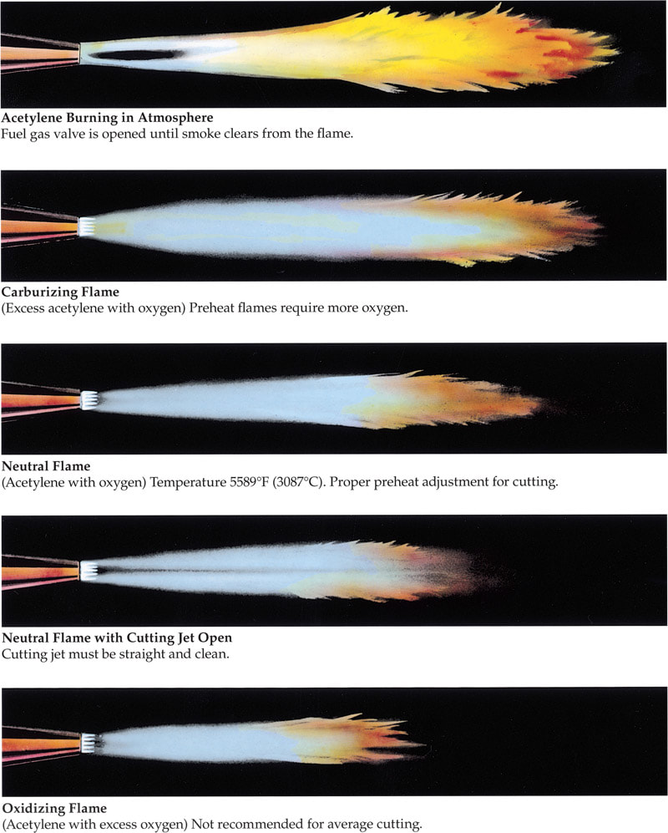
PROCESS BASICS (oxy-fuel cUTTING)
If we can get a shot of neutralizing the flame.
Base Material should be preheated with a neutral flame (1:1 ratio of Acetylene and Oxygen)
This is only to increase the susceptibility of rusting by the base metal not to melt the base material.
Oxygen jet valve is then depressed to release a stream of oxygen to the material. If the material is properly pre-heated a cut will initiate.
Note: When piercing it must make it through the first time. Any dross that has been expelled cannot but re-cut but can be blown through the hole.
http://www.halversoncts.com/43-oxygen-cutting-process.html

Slide 15
Cutting (oxy-fuel cUTTING)
Video of cutting
When Cutting it is best to move as fast as possible without loosing the exothermic reaction.
Moving with this speed will lag the bottom of the cut slightly with the top of the cut so be sure to let it catch up at the end of a cut.
If there is an excessive dragline then the oxygen pressure is too low, or you are moving too fast.
The correct speed and pressure will result in a clean cut with minimal dross to be removed.
Correct Cut
Too Fast, Note the buildup of Dross along the edge.

Slide 16
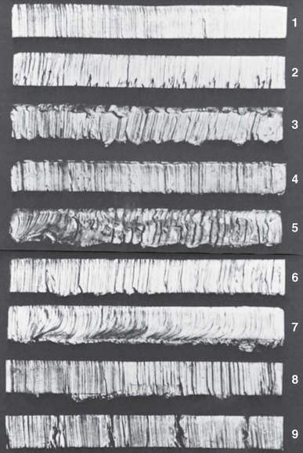
Cutting (oxy-fuel cUTTING)
​(1) A good cut in 1″ (25.4mm) plate. The edge is square, and the drag lines are essentially vertical and not too pronounced.
(2) The preheat flames were too small for this cut, and the cutting speed was too slow, causing bad gouging at the bottom.
(3) The preheating flames were too long, causing the top surface to melt over. The cut edge is irregular, and there is an excessive amount of adhering slag.
(4) The oxygen pressure was too low, resulting in the top edge melting over because of the slow cutting speed.
(5) The oxygen pressure was too high and the nozzle size too small, so that control of the cut was lost.
(6) The cutting speed was too slow, emphasizing irregularities of the drag lines.
(7) The cutting speed was too fast, resulting in a pronounced break in the dragline, and an irregular cut edge.
(8) The torch travel was unsteady, resulting in a wavy and irregular cut edge.
​(9) The cut was lost and not carefully restarted, causing bad gouges at the restarting point. (American Welding Society)
http://www.halversoncts.com/146-cutting-steel-with-the-oxyfuel-gas-cutting-torch.html

Slide 17
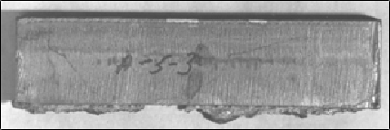
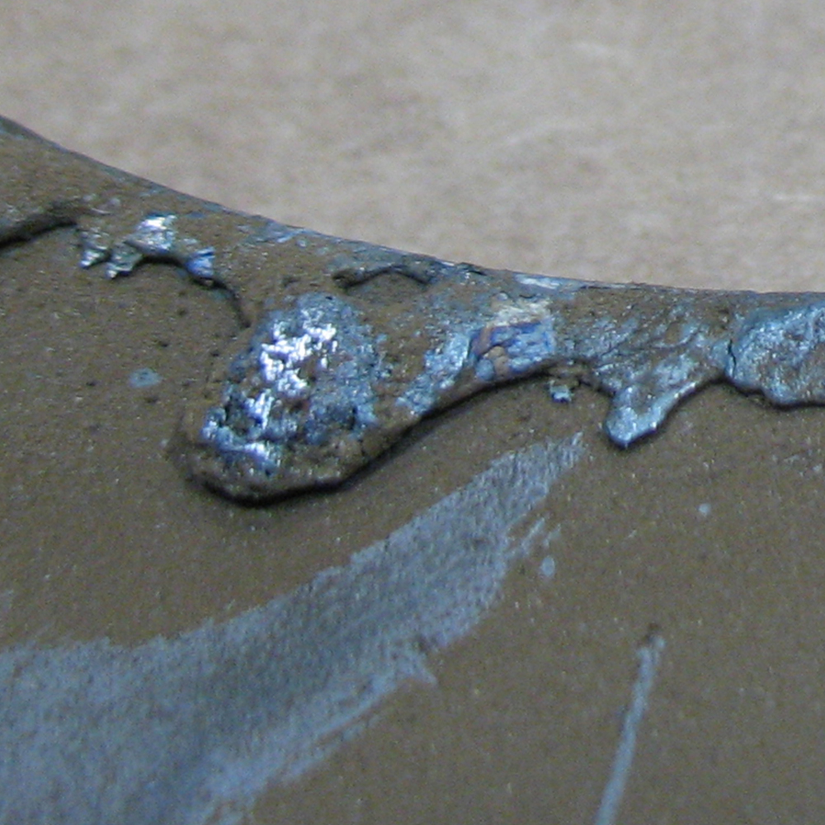
Cleaning (oxy-fuel cUTTING)
Removing Dross
All dross should be removed prior to subsequent processing.
The surface of the cut should be ground prior to welding to remove any residual oxidation caused by cutting.
Most dross can be removed with a pair of pliers.
http://www.gas-tec.com/flamecutting.html
https://timesaversinc.com/heavy-slag-removal
http://www.halversoncts.com/146-cutting-steel-with-the-oxyfuel-gas-cutting-torch.html

Slide 18
RECAP
EQUIPMENT SETTINGS
TUNGSTEN PREP
WELDING TECHNIQUES

Slide 19
Closing Statement
Again thank you for watching unit 5 of Welder Training I’m Andrew Beirnes with Hog Tech University.
See you on the next Unit!

