Slide 1
Welcome back to HOG Tech University
I’m Andrew Beirnes
Welding Engineer & Certified Welding Inspector

Slide 2
GMAW (Gas metal arc welding)
FCAW (flux core arc welding)
WELDER TRAINING UNIT 5

Slide 3
OBJECTIVES
PROCESS BASICS
EQUIPMENT SETTINGS
ARC TRANSFER MODES
SETTINGS EFFECTS ON WELD
WELD ANGLES
UPHILL VS DOWNHILL
TECHNIQUES

Slide 4
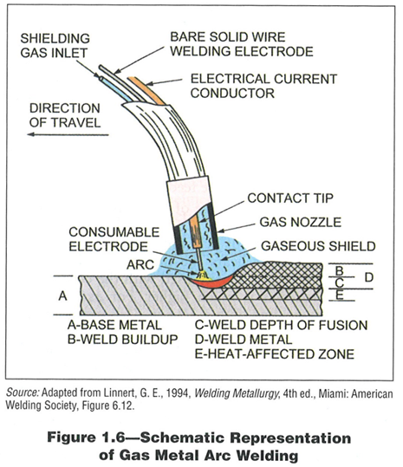
PROCESS BASICS (GMAW)
Video Of Welding Torch & Weld
•Gas Metal Arc Welding uses a consumable wire electrode that is constantly fed toward the weld pool.
•It uses bottled CO2 or other CO2 mixed gases to protect the weld pool while molten.
•GMAW keeps the voltage constant while varying the Amperage to maintain a stable arc. Amperage is usually determined by the distance between the electrode and base metal along with the wire feed speed.

Slide 5
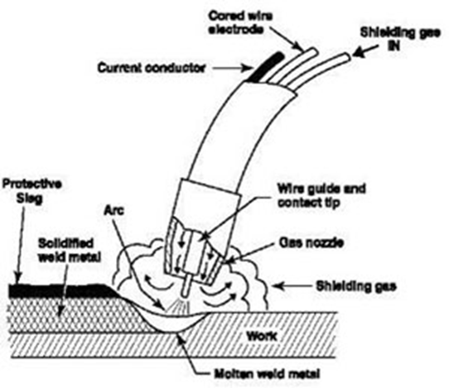
PROCESS BASICS (fcaw)
Video Of Welding Torch & Weld With Slag
•Flux Core Arc Welding is similar to SMAW however the electrode contains flux, Typically in the center of the wire.
•Pending on the flux shielding gas may or may not be required. When it is required it is typically for establishing a higher quality arc and mechanical properties.

Slide 6
equipment setup
Video Weld Equipment Setup Steps
Plug in the Welder
Power Switch Location
Ground Placement
Correct Wire
Correct Gas for the Wire
Changing Wire

Slide 7
equipment settings
Video of front of welder.
There are two main settings on a GTAW/FACW welding machine.
WFS - Wire Feed Speed. (Amperage)
V - Voltage. (Constant)
Correctly managing these settings is critical to GMAW/FCAW process. It can mean the difference between a good weld and a failed weld.

Slide 8
equipment settings (WFS)
WFS - Wire Feed Speed. (Amperage)
When not listed on the WPS the WFS can be determined by material thickness or experiential knowledge.
The following equation will get you close, but will still have to be fine tuned.

Slide 9
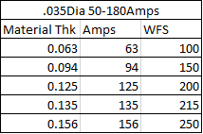
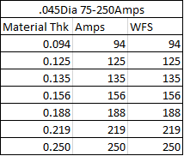
equipment settings (WFS)
Recommended Amp Ranges for Wire Dia and Corresponding Thickness.
Single Pass Only.

Slide 10
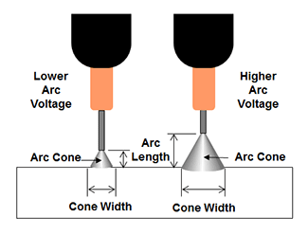
equipment settings (Voltage)
Video of Welding With
Low Voltage.
High Voltage.
(Pool Width, Side by Side Footage)
Voltage is held constant during welding.
Voltage controls the Arc Length and shape.
Lower Voltage = Shorter, Narrower Arc.
Higher Voltage = Longer, Wider Arc.
https://www.lincolnelectric.com/en-gb/support/process-and-theory/Pages/constant-current-vs-constant-coltage-output.aspx

Slide 11
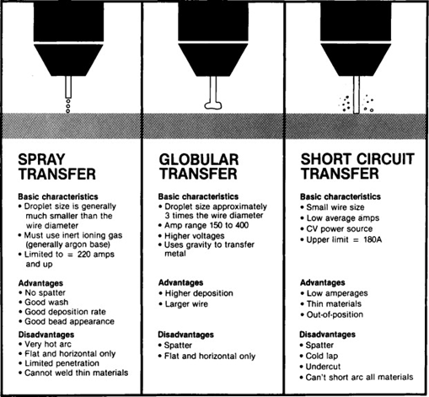
arc transfer modes
Use Youtube Videos, Side by Side if Possible.
GMAW Welding can operate in Four Modes
Short-Circuit
Globular
Spray
Pulse
Easiest way to change between modes is to vary the voltage.
Typical Settings for .035dia wire.
22-25V - Short Circuit
25-28V - Globular
28-32V - Spray
Note: Pulse Arc can be any combination of Short-Circuit, Globular, or Spray.
Note: These Settings may vary based on equipment, wire type, and Amperage.

Slide 12
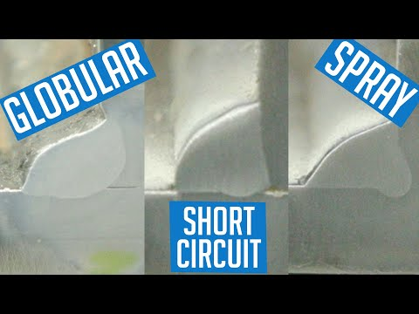
SETTINGS EFFECTS ON WELD
Video of People Welding, All positions. Video of Welding with Hardfacing.
Short-Circuit is the primary Transfer Mode used at Hog since it works in all positions and achieves moderate results.
There will be situations when other Modes will work better or are required by the WPS.
https://www.youtube.com/watch?v=XkbgXQ7Wl-Y

Slide 13
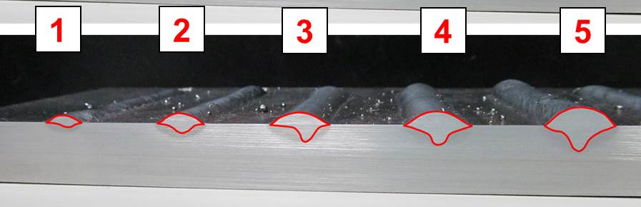
SETTINGS EFFECTS ON WELD
Video of Welding with Different Amperages.
Side By Side Video.
Video Showing the amount of Plume From Each One. Sequential Min/Max.
Increasing the WFS beyond recommended limits can increase penetration.
However there are drawbacks, Over Amping the wire will result in lower efficiency. Meaning that less of the wire is being deposited on the plate. The wire is vaporized due to the higher Amperage.
In this instance all variables were held constant other than Wire Feed Speed.
WFS Low -> High
Note: 3-5 are Spray Transfer
https://ewi.org/gas-metal-arc-welding-basics-welding-current-welding-voltage/

Slide 14
SETTINGS EFFECTS ON WELD
Video of Welding Pool Shape.
Round - Middle Input
Round - Edge Input
Tear Drop - Edge Input
Heat Input is a combination of Weld Settings and Travel Speed.
This Impacts Penetration and weld shape.
The change in Weld shape can impact penetration.
In this instance Travel Speed was changed, along with WFS and Voltage to maintain the same Heat Input per weld.
Welding Faster with the same heat Input Changes the weld pool shape so it penetrates more. (Arc on edge of puddle instead of center of puddle)
Travel Speed High -> Low (Same Heat Input)
https://ewi.org/gas-metal-arc-welding-basics-travel-speed-and-contact-to-work-distance-ctwd/

Slide 15
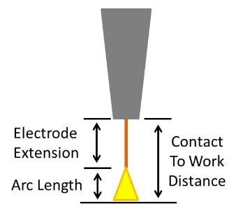
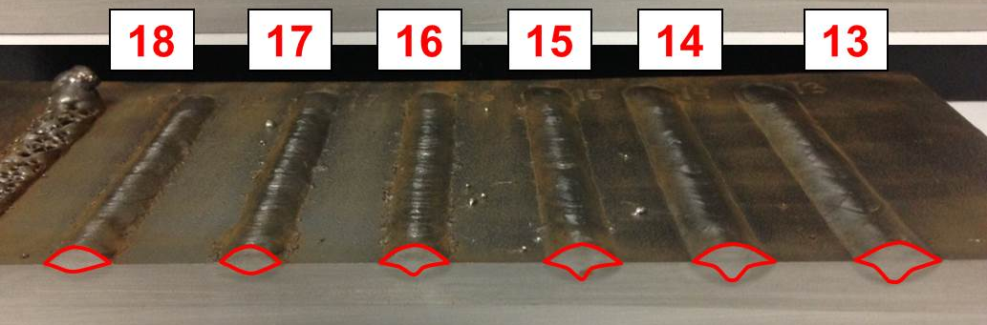
SETTINGS EFFECTS ON WELD
Video of Wire Length Coming out of the Gun.
Welding With Different Wire Lengths (Min/Max)
Contact to Work Distance
Distance between the Nozzle and the workpiece.
Changing the Contact To Work Distance can also Change the shape and Penetration of the weld pool.
Shorter Contact to work Distance Increases Penetration.
In this instance all variables were held constant other than Contact to Work Distance. ⅜”Min - 1”Max
Contact to Work Distance: Longer -> Shorter
https://ewi.org/gas-metal-arc-welding-basics-travel-speed-and-contact-to-work-distance-ctwd/

Slide 16
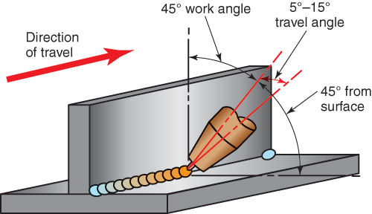
WELDING ANGLES
Video of Travel Angle & Work Angle,
No Arc.
Groove Weld.
Fillet Weld.
TKY Connection.
Pipe.
Travel Angle
Angle Linear to the Weld.
Work Angle
Angle Perpendicular to the weld.
http://www.halversoncts.com/910-welding-joints-in-the-horizontal-welding-position.html

Slide 17
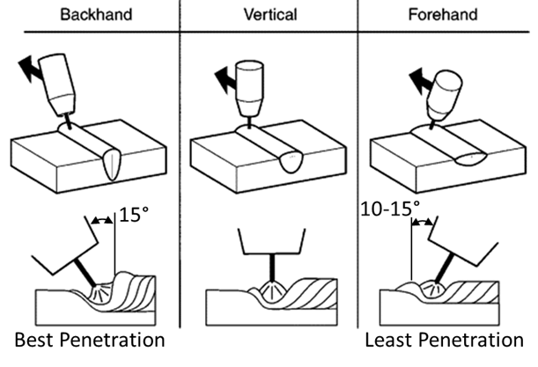
WELDING ANGLES
Video of Welding Forehand
& Backhand
FOREHAND VS BACKHAND
Welding Forehanded vs Backhanded can also change the shape of the weld.
Backhanded will result in deeper penetration than forehanded.

Slide 18
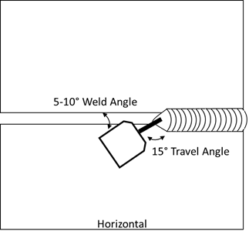
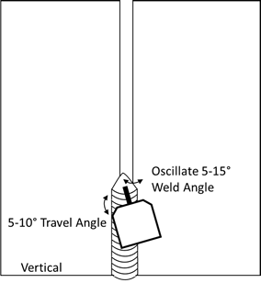
WELDING ANGLES
Video of welding horizontal and vertical.
General Shot.
Weld Pool.
HORIZONTAL & VERTICAL

Slide 19
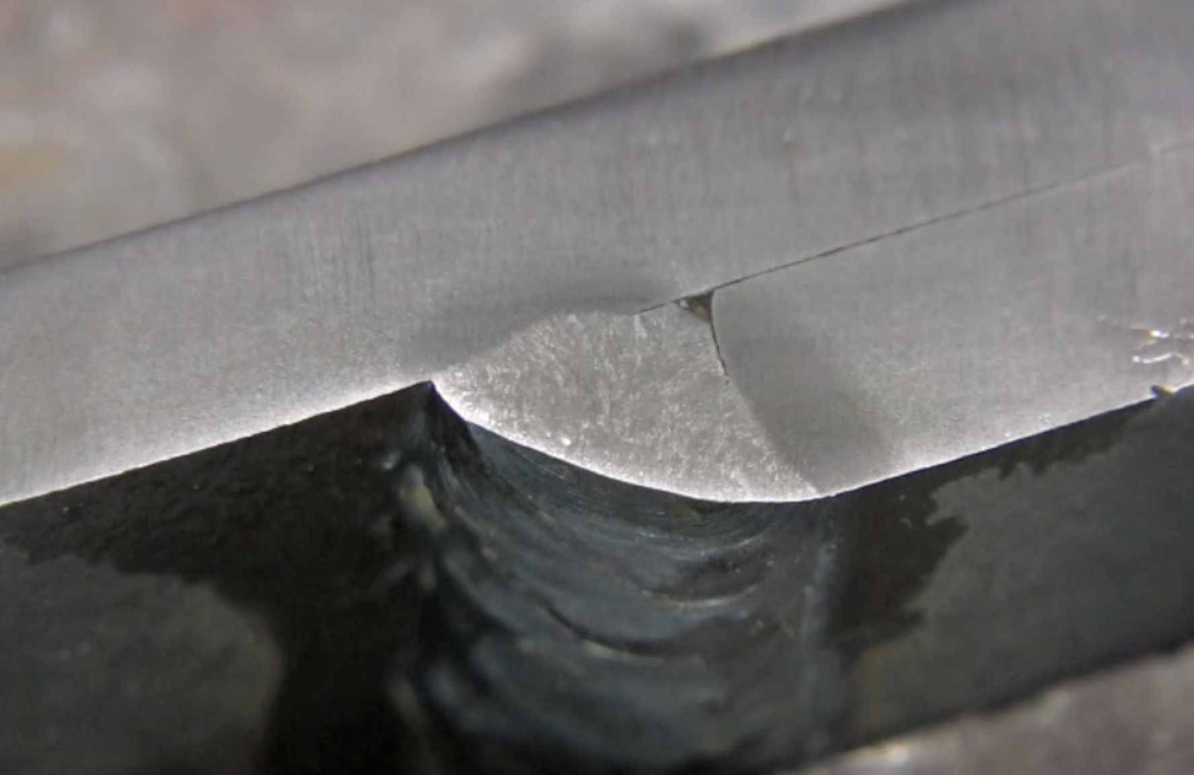
Uphill vs downhill
Video of Weld Pool, Uphill & Downhill.
UPHILL
Uphill results in more penetration than downhill.
Uphill is considered the industry standard for structural welding.
DOWNHILL
Downhill is typically used on sheet metal due to the lower penetration than uphill, and faster travel speed.
Downhill can also be used when tested. Testing will establish a WPS that will result in a satisfactory weld made using the Downhill orientation.
DOWNHILL MIG WELD. NOTE THE LACK OF PENETRATION AT THE ROOT LEADING TO A CRACK ALONG THE HEAT AFFECTED ZONE.
https://www.weldingtipsandtricks.com/mig-welding-downhill.html

Slide 20
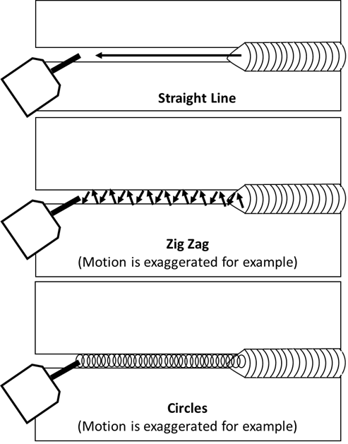
tECHNIQUES
Video looking at weld pool, showing the three different techniques.
Straight Line
Laying a bead with no movement of the torch other than in the direction of travel.
Zig-Zag
Without changing the Travel or Weld Angle the torch is moved back and forth between the workpieces staying within the established weld pool. These movements are small and tight.
Circles
Without changing the Travel or Weld Angle the torch is moved in a circular motion like a tight cursive e that overlap. The motion stays within the weld pool and is tight/small movements.

Slide 21
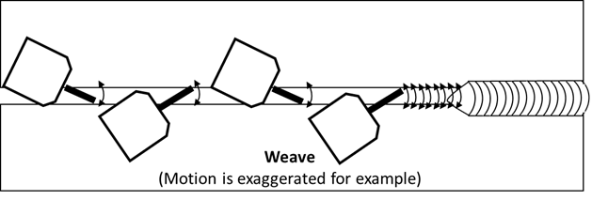
tECHNIQUES
Video looking at weld pool, showing technique.
No Arc, Showing Technique.
Technique “Weave”
The Weave Technique oscillates the Weld Angle between the workpieces while maintaining the Travel Angle. The severity of the Oscillation and the width of the weld bead are dependent on the joint geometry. This technique is also useful for bridging gaps in material.

Slide 22
tECHNIQUES
Video looking at weld pool, showing Modified Techniques. (4 Total)
Flux Core
Flux Core can be welded with the previous techniques. It is best to slightly modify the technique for better quality.
When using Flux Core it is best to keep the puddle molten for a longer period of time than with other welding processes, this gives the flux(aka slag) more time to move to the surface of the material reducing the chance of a slag inclusion. This also aids in the thermal cycling of the material slowing down the cooling rate which reduces the risk of hot cracking, and piping porosity.

Slide 23
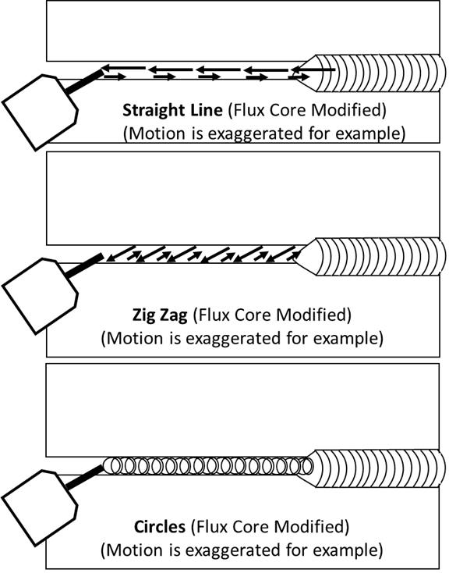
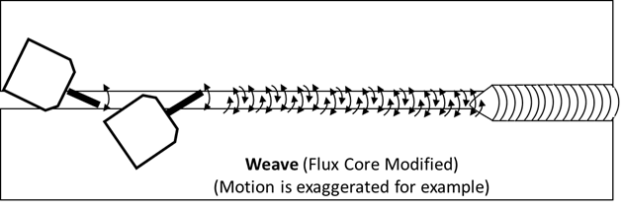
tECHNIQUES
Video looking at weld pool, showing Modified Techniques. (4 Total) -Continued.
Flux Core
The basis of the technique is to go back over the area that is already molten before continuing the weld. Think of it as two or three steps forward and one step back. For this reason, the circle technique works well, and the Zig-Zag technique works with an additional back step. Again, any technique can be modified to work with Flux Core so long as it keeps the molten pool molten for longer.

Slide 24
RECAP
Montonge of the things covered. Slide 6 Video, Slides 9, Slide 11 Video, Slide 16 No Arc, Slide 18 video, Slide 14 Pool shape.
PROCESS BASICS
EQUIPMENT SETTINGS
ARC TRANSFER MODES
SETTINGS EFFECTS ON WELD
WELD ANGLES
UPHILL VS DOWNHILL
TECHNIQUES

Slide 25
Closing Statement
Again thank you for watching unit 5 of Welder Training I’m Andrew Beirnes with Hog Tech University.
See you on the next Unit!

